Slide 1
CSE2521 – Database Management Systems (DBMS)
Shekh. Md. Saifur Rahman

Slide 2
Data and Information
Raw vs Processed
Meaningful or not

Slide 3

Why Database?
Store
Retrieve
Update
Delete

Slide 4
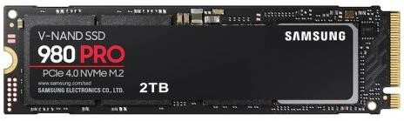

Why Database?
Memory
Volatile (Register, Cache, RAM)
Non-Volatile (SSD, HDD)

Slide 5



Why Database?
List (array, map, tree)
File System
Database

Slide 6

Why Database?
EFFICIENT
INTEGRITY AND CONSISTENCY
SECURITY
REDUNDANCY
CONCURRENCY

Slide 7





Types of Databases
Relational Database
NoSQL Database

Slide 8

Where do we use Database?
Enterprise Information
Manufacturing
Banking and Finance
Educational Institutes

Slide 9


Where do we use Database?
Transportation
Telecommunication
Web Services
Document Database

Slide 10

View of Data
Data Abstraction
Hides the complexity of data structures
Data Models

Slide 11
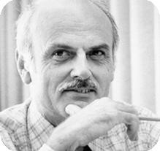




Relationship Model
Columns
Rows
Ted Codd
Turing Award 1981

Slide 12









































Relationship Model

Slide 13
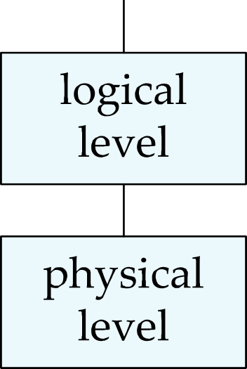
Abstraction

Slide 14
Data Definition Language (DDL)
Specification notation for defining the database schema
create table instructor (
ID char(5),
name varchar(20), dept_name varchar(20), salary numeric(8,2))
DDL compiler generates a set of table templates stored in a data dictionary
Data dictionary contains metadata (i.e., data about data)
Database schema
Integrity constraints
Primary key (ID uniquely identifies instructors)
Authorization
Who can access what

Slide 15
Data Manipulation Language (DML) / Query Language
For accessing and updating the data
Two types
Procedural DML -- what data are needed and how to get those data.
Declarative DML -- what data are needed.
Declarative DMLs are usually easier to learn and use.

Slide 16
https://www.db-book.com/
Resources
https://www.db-book.com/slides-
dir/index.html

